Slide 1
Face-mask & Social- distance detection
Group member: Eddy, Ronald, David
20-11-2020

Slide 2
Business Question
Data Collection & preprocessing
Face detection model analysis
Face mask detection model analysis
1
2
3
4

Slide 3
Distance measurement
Code explanation
Conclusion & Further improvement
5
6
7

Slide 4

Business Question
“Masks should be used as part of a comprehensive strategy of measures to suppress transmission and save lives”
World Health Organization (WHO)

Slide 5
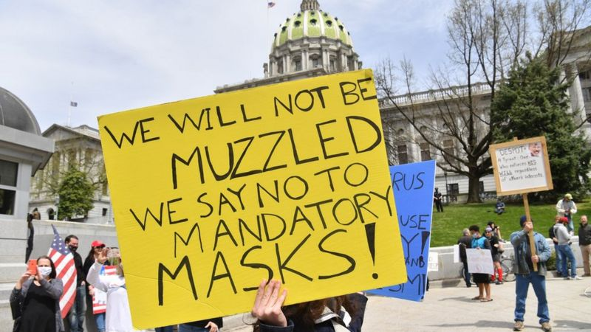
Business Question

Slide 6
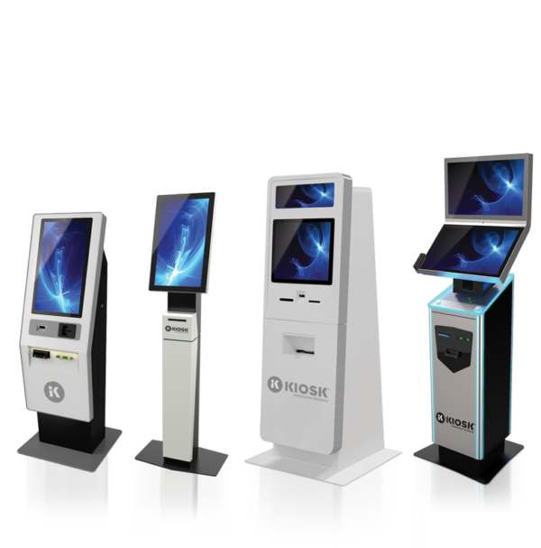
Business Question
Using AI technology to detect possible violation of mask wearing and social distancing rules so as to help prevent the spread of COVID-19.
Notes:
integrated into retail point-of-sales systems, security cameras, digital signage and other connected devices to determine that individuals in required areas are wearing a face mask, and notifying pre-designated personnel if they are not. As health officials continue to call for individuals to wear masks whenever they are in public to prevent the spread of COVID-19, facial recognition engines must evolve to help businesses, municipalities and other organizations remain compliant with these guidelines and protect people at large.

Slide 7
How it works
Face Detection
Our final Model
Social Distance Detection
Face-mask Detection
Notes:
integrated into retail point-of-sales systems, security cameras, digital signage and other connected devices to determine that individuals in required areas are wearing a face mask, and notifying pre-designated personnel if they are not. As health officials continue to call for individuals to wear masks whenever they are in public to prevent the spread of COVID-19, facial recognition engines must evolve to help businesses, municipalities and other organizations remain compliant with these guidelines and protect people at large.

Slide 8
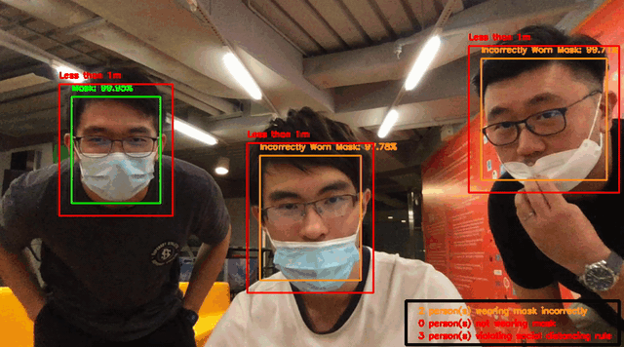
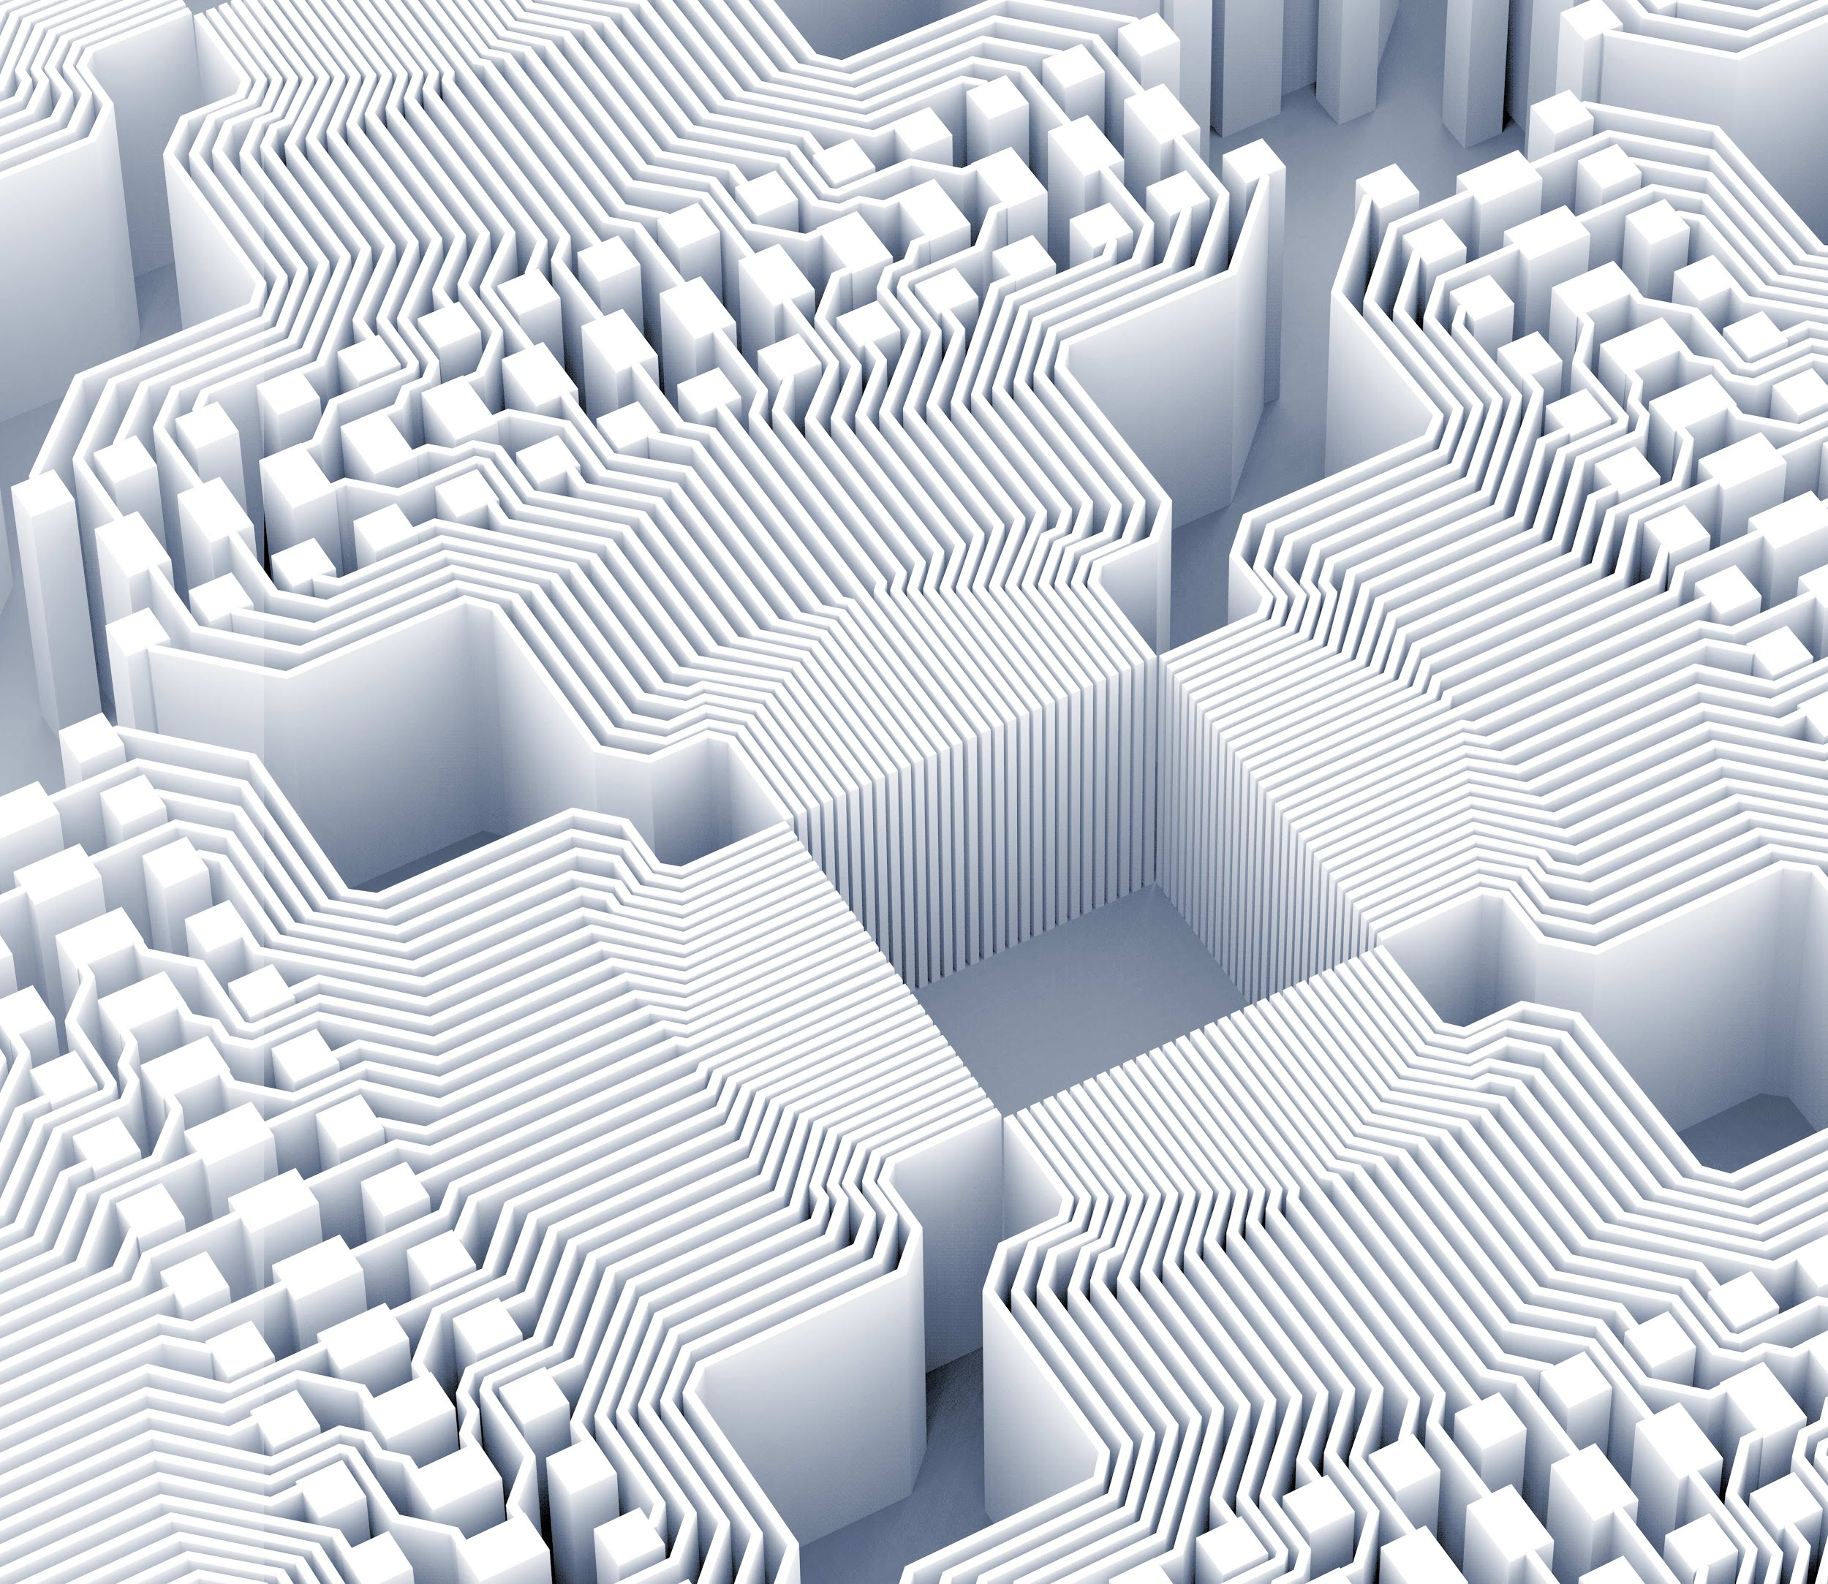

Slide 9
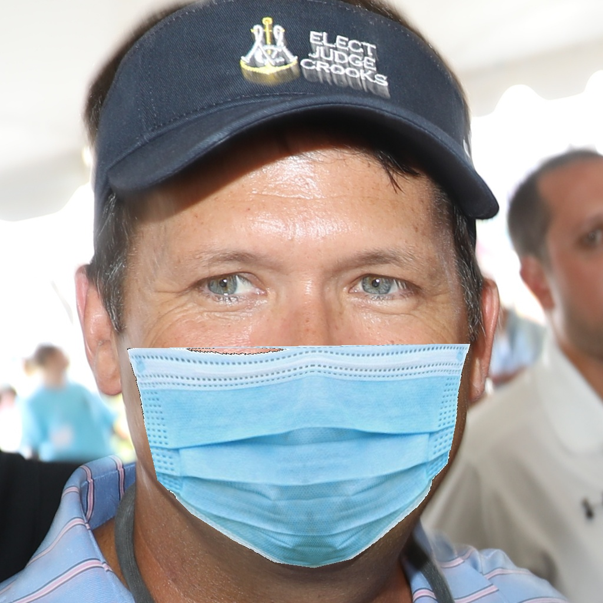
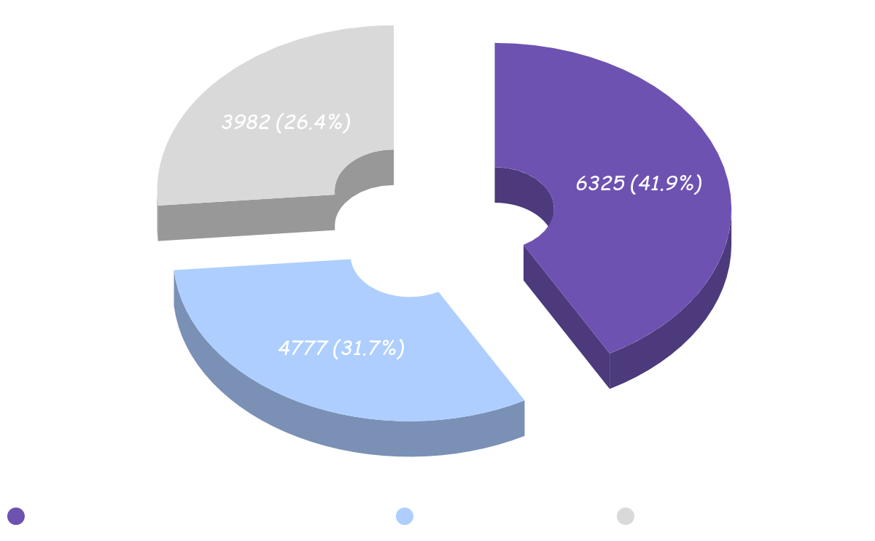
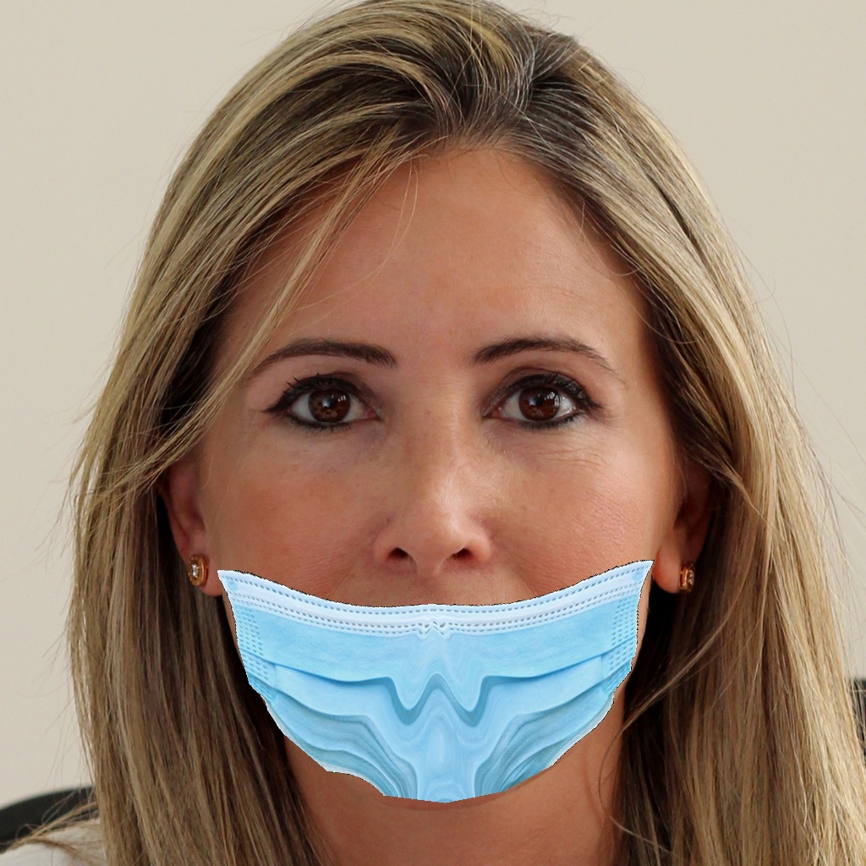
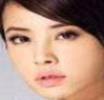
Data Collection
15,084 images

Slide 10
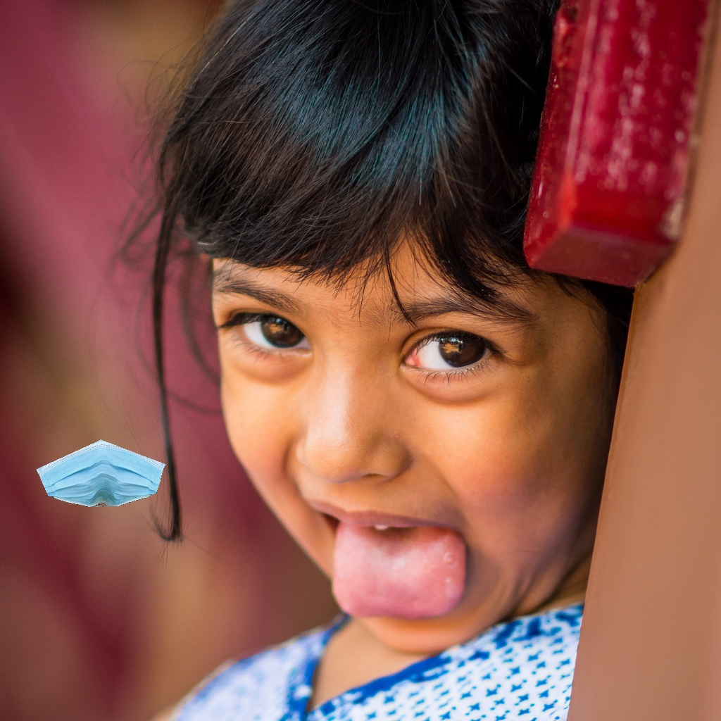
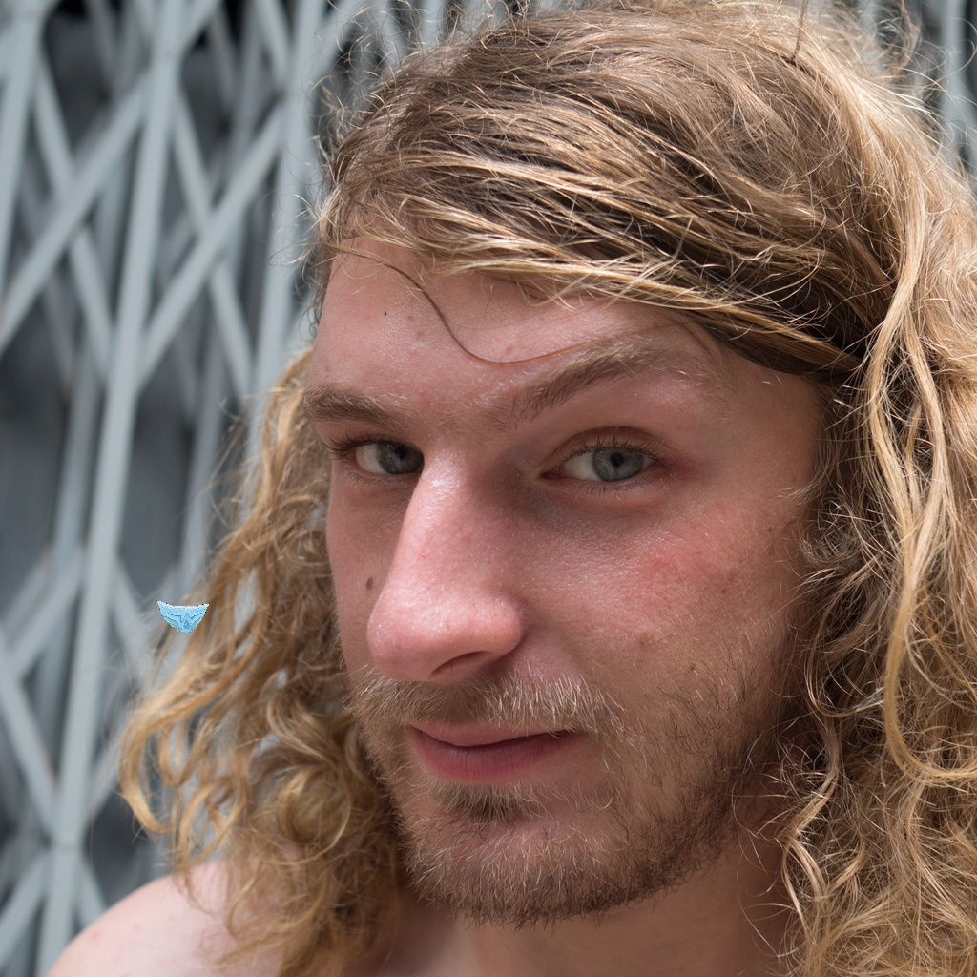
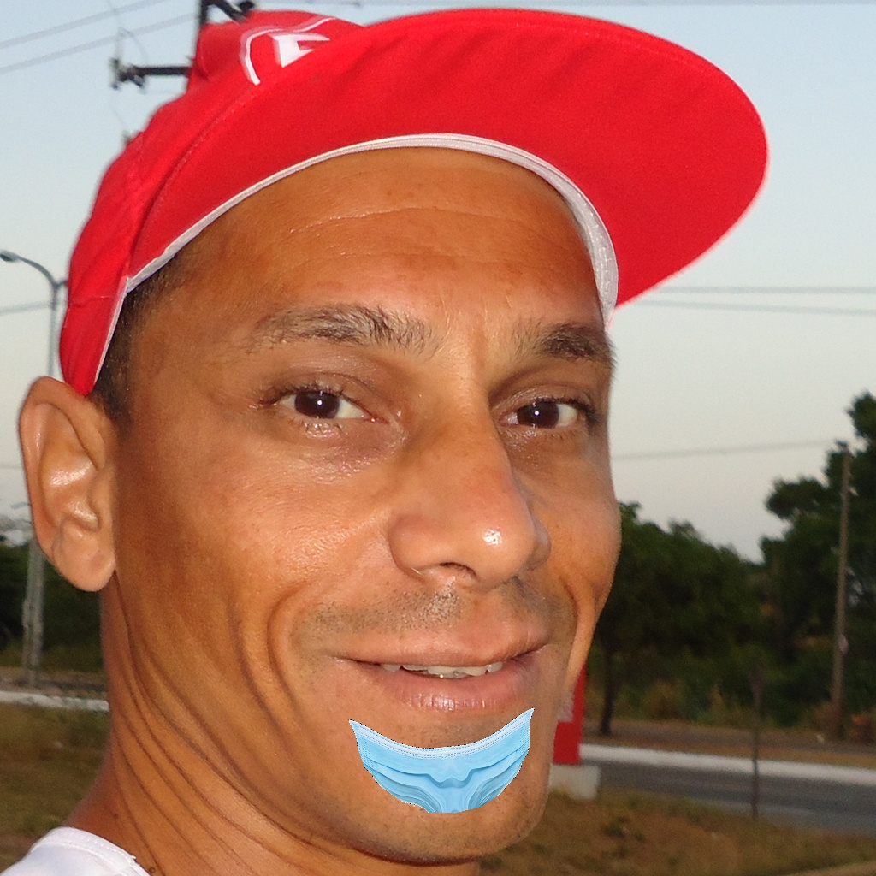
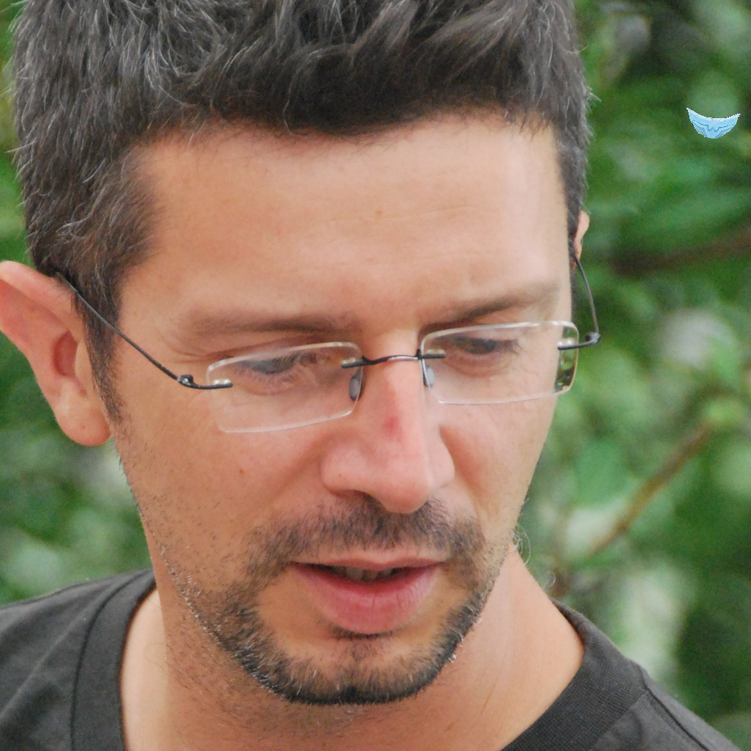
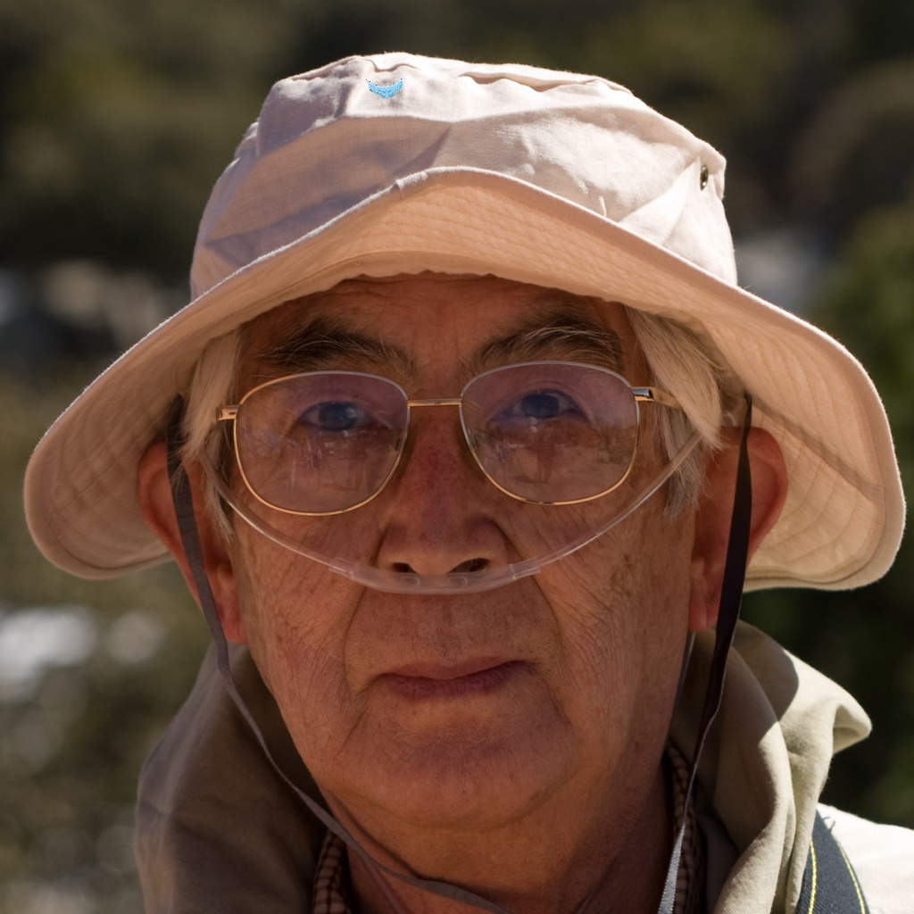
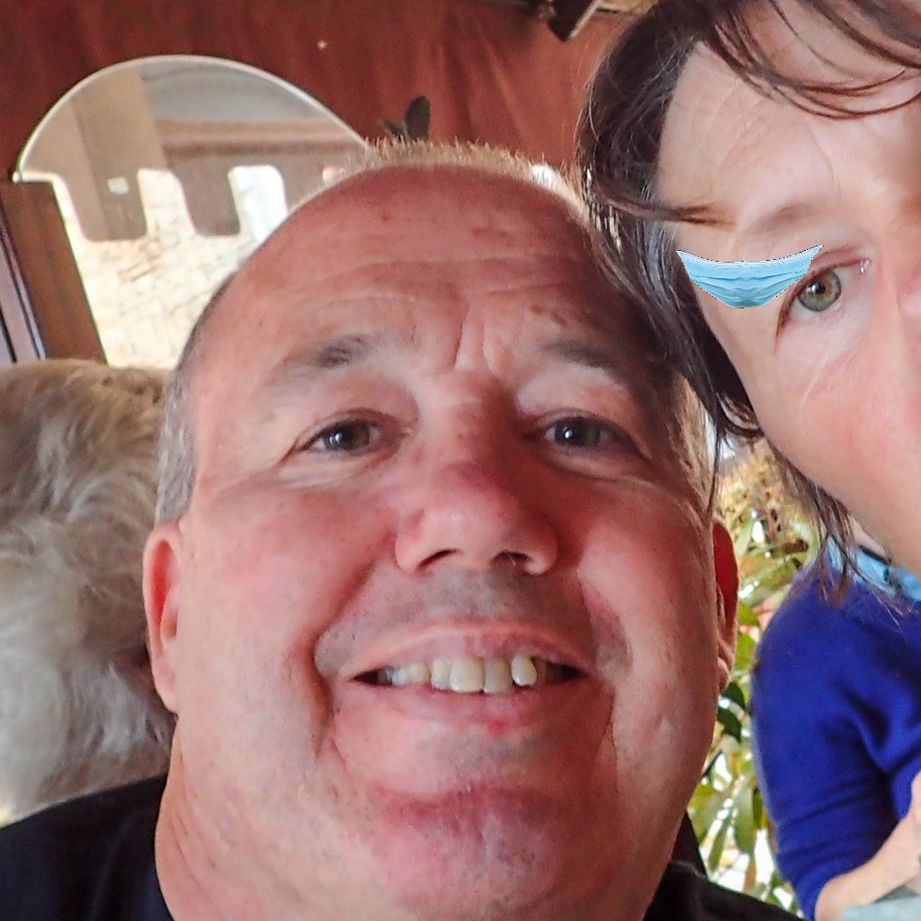
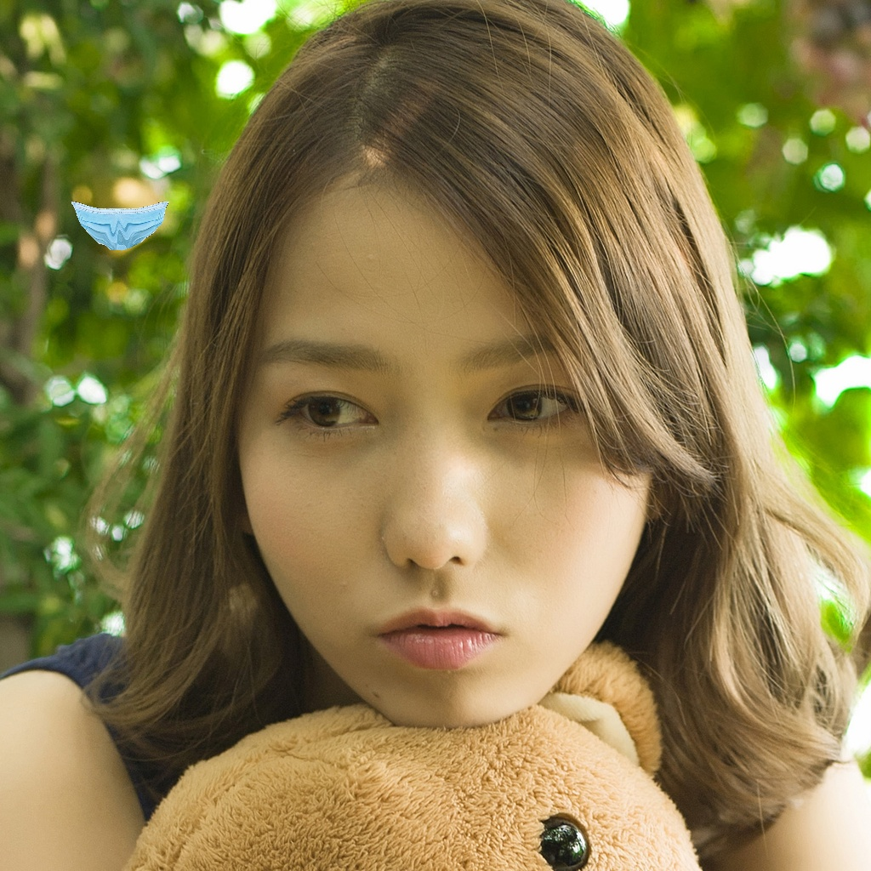
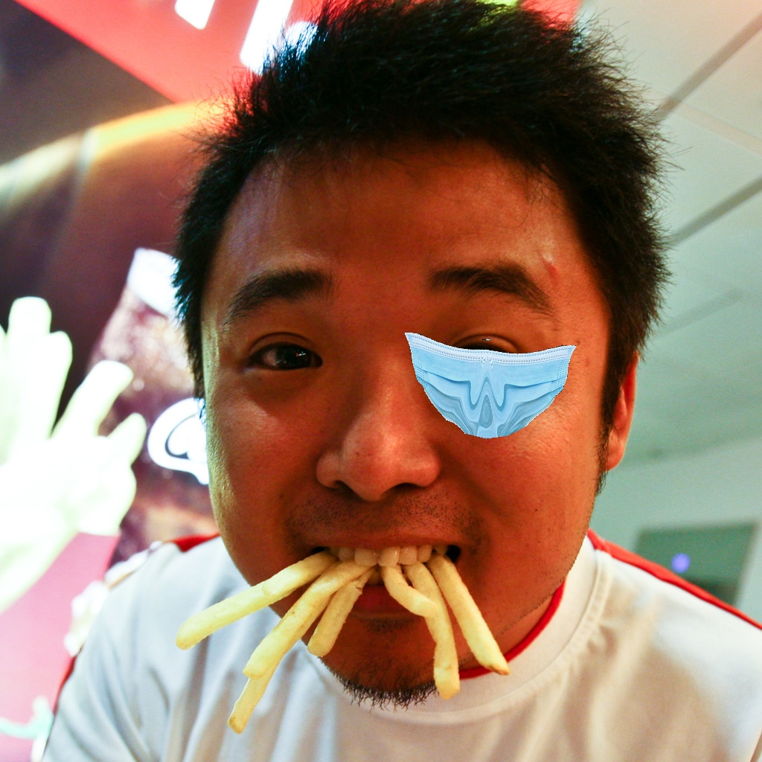
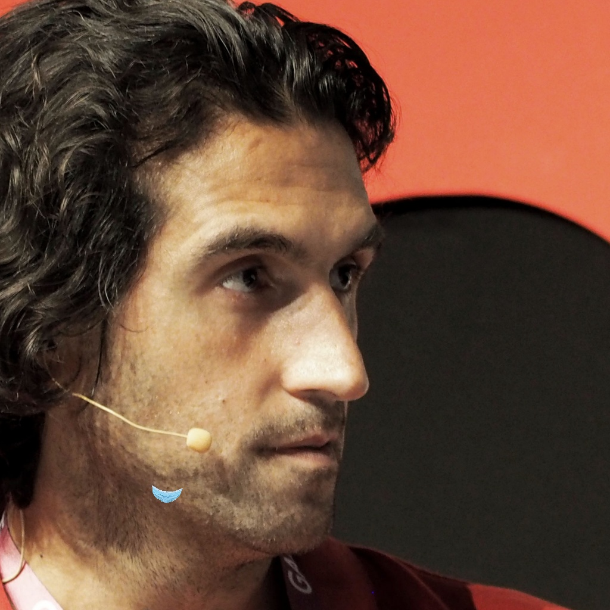
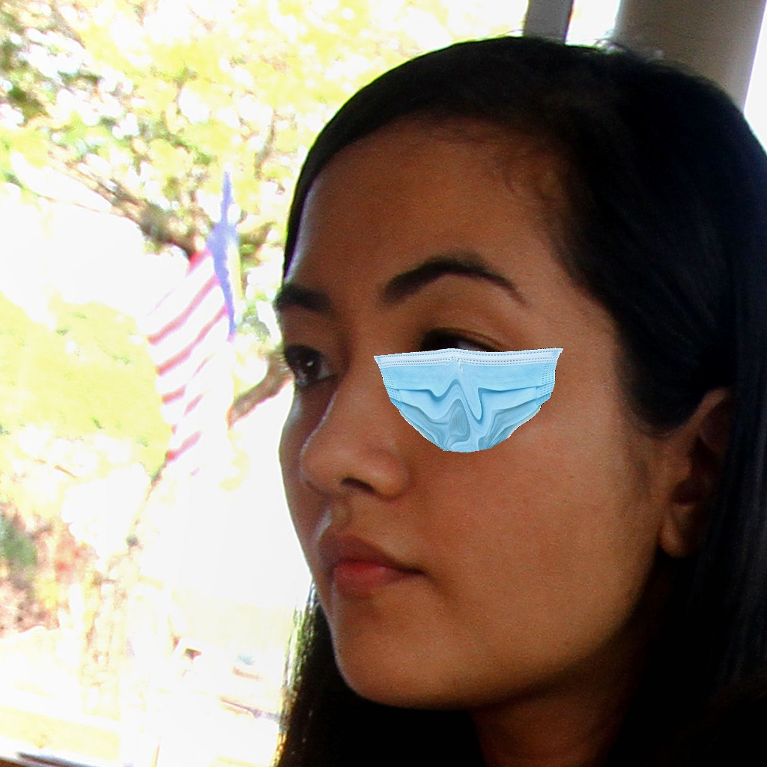
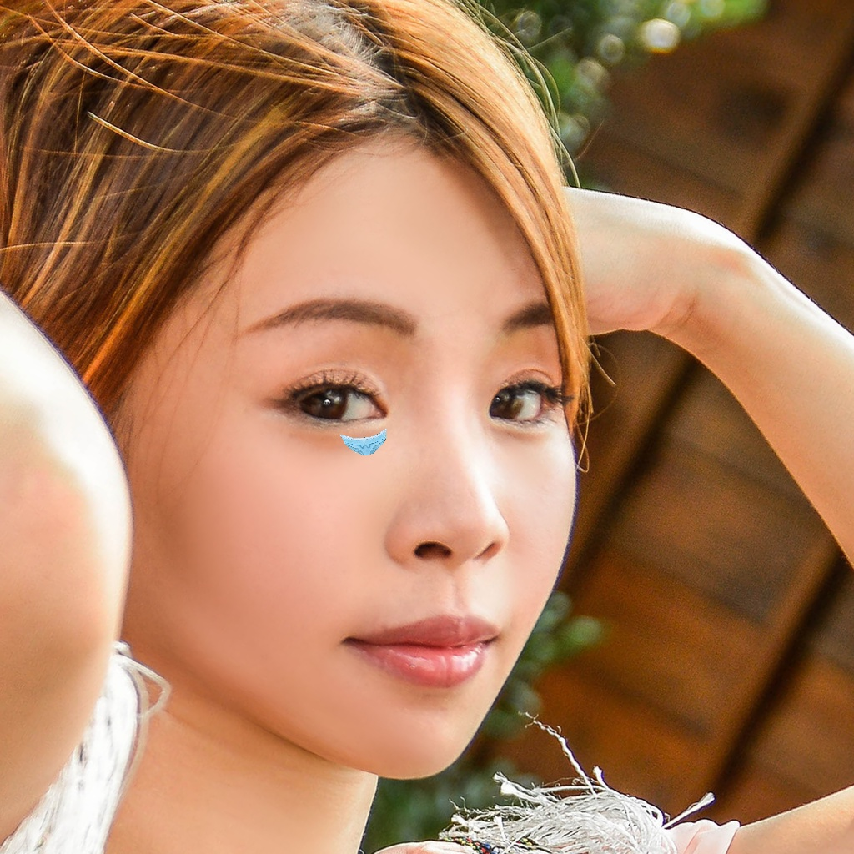
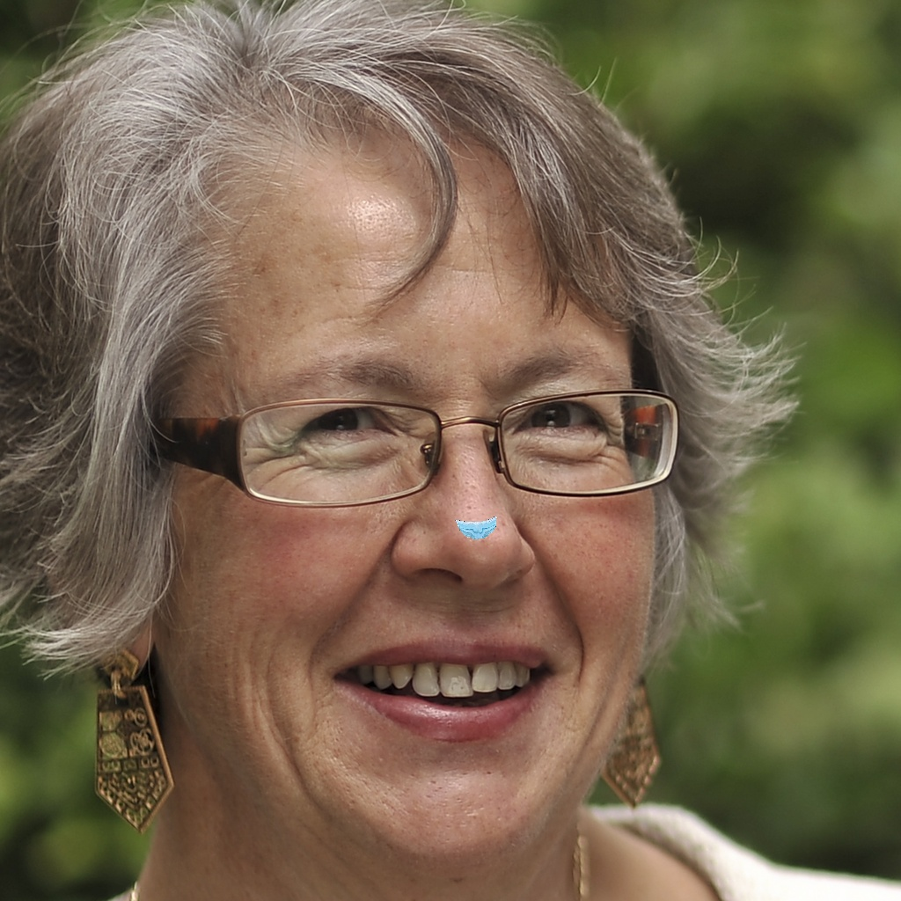
Data Pre-processing

Slide 11
Face detection models comparison
Face detection model
Haar Cascade
Dlib Frontal Face Detector
MTCNN
OpenCV DNN
Res10_300x300(caffeemodel)
Which one should we use ?
Notes:
After preprocessing the data, we were going to select the optimum face detector to detect our face. Here are four kinds of popular face detectors in this day.
So, we’hv compared these four face detectors with each other in different extreme situation.
Let’s see the performance~
Dlib: use linear SVM machine learning algo to perform face detection
MTCNN: 3 stages ----- proposal network, refine network ouput n.

Slide 12
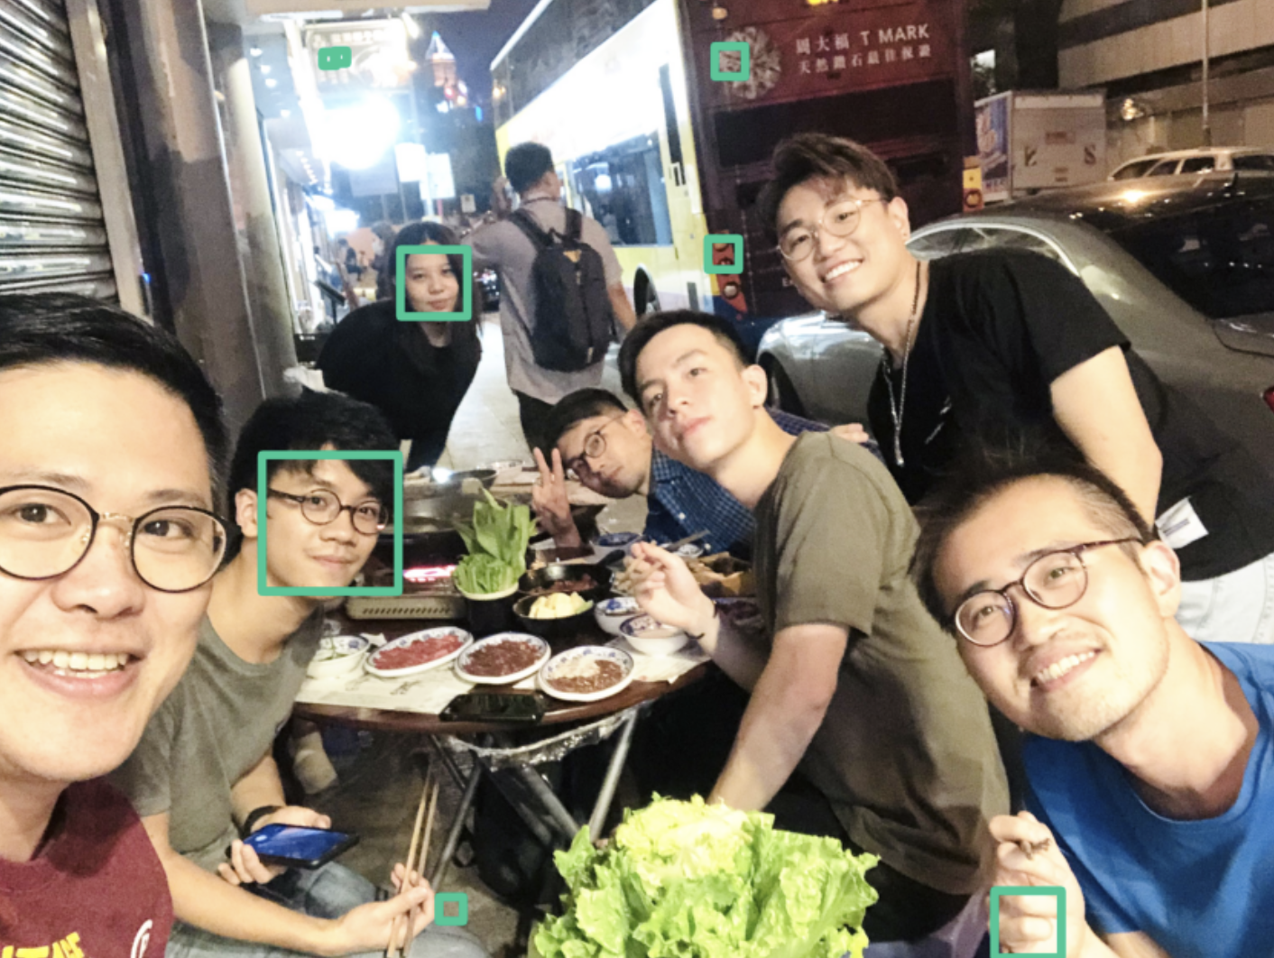
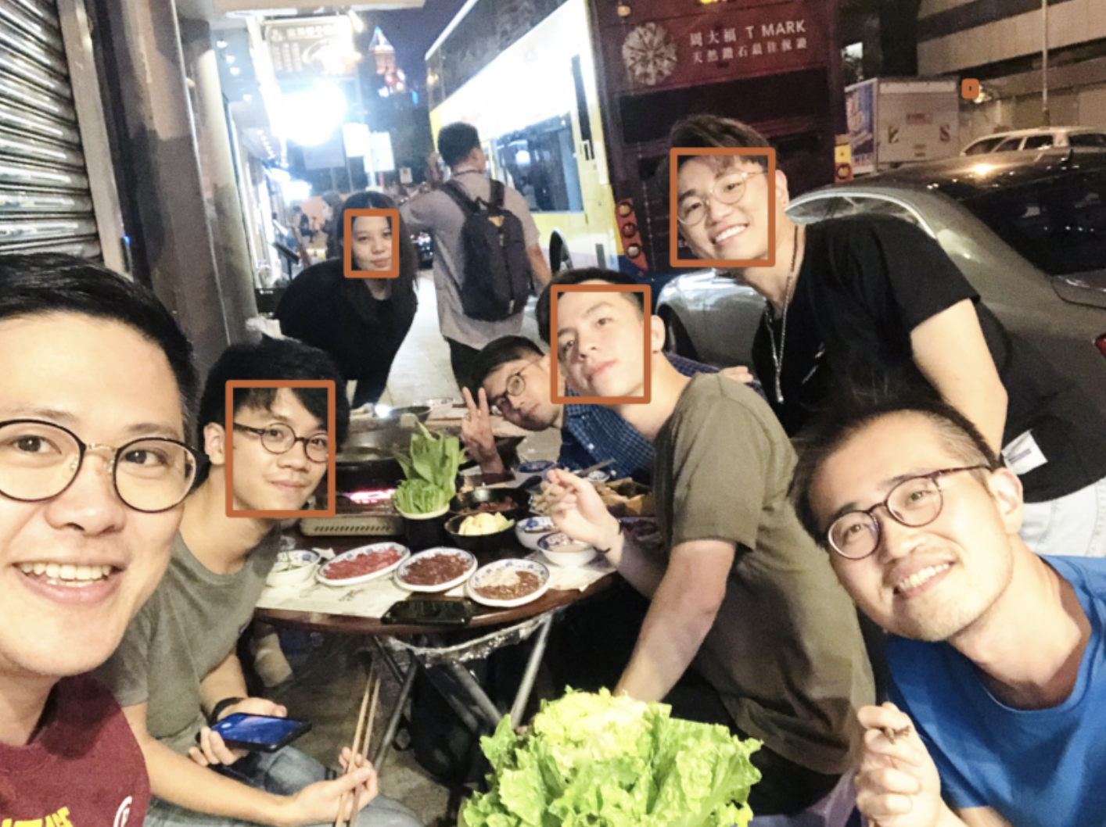
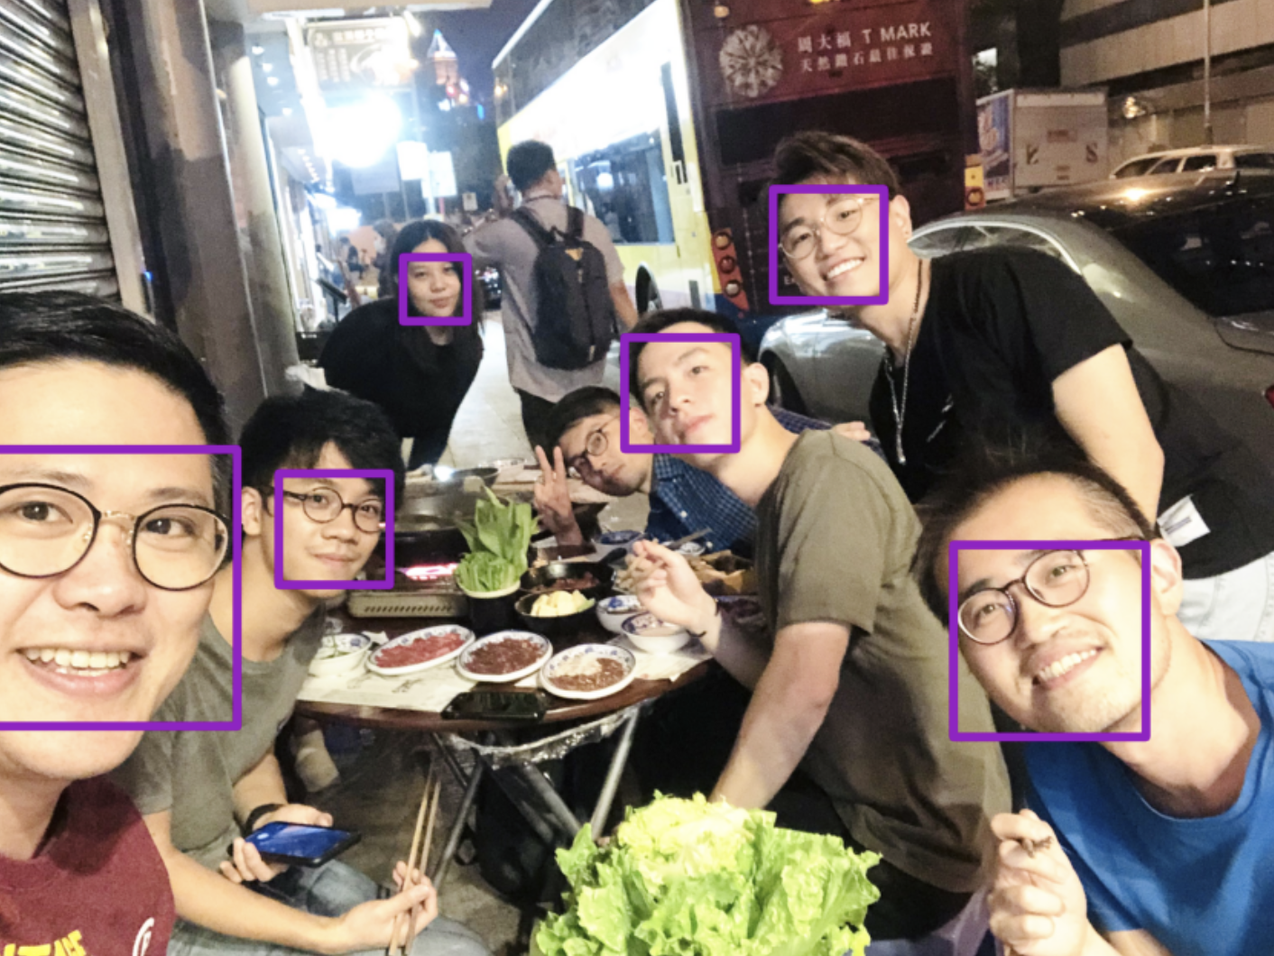
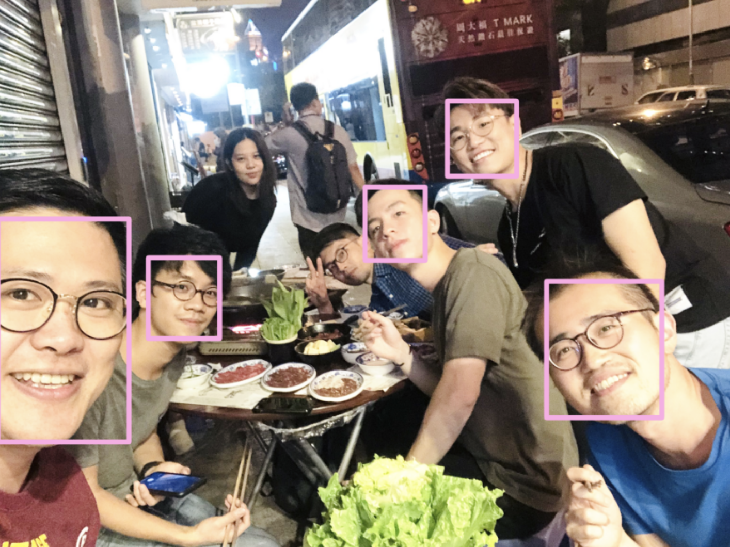
Face detection models comparison
-High light intensity
haar
mtcnn
dlib
dnn
Notes:
Under the high light intensity environment, dlib performs the best: it can detect nearly all faces except… haarcascade performs the worst, it makes a lots of mistakes. Mtcnn and dnn is so far so good in this case.

Slide 13
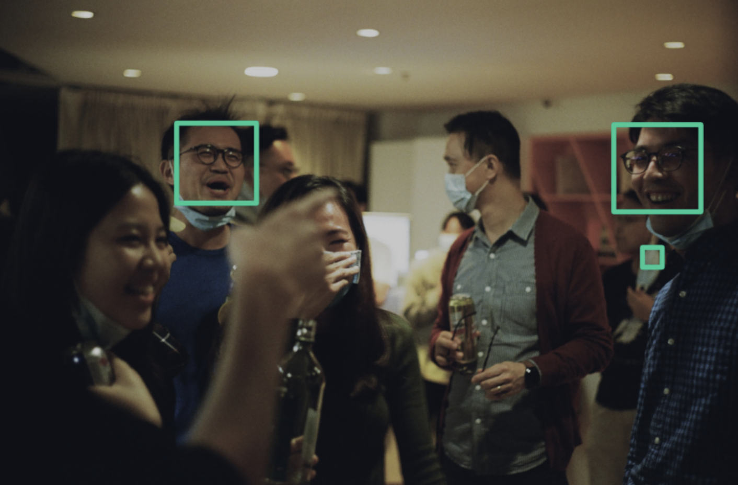
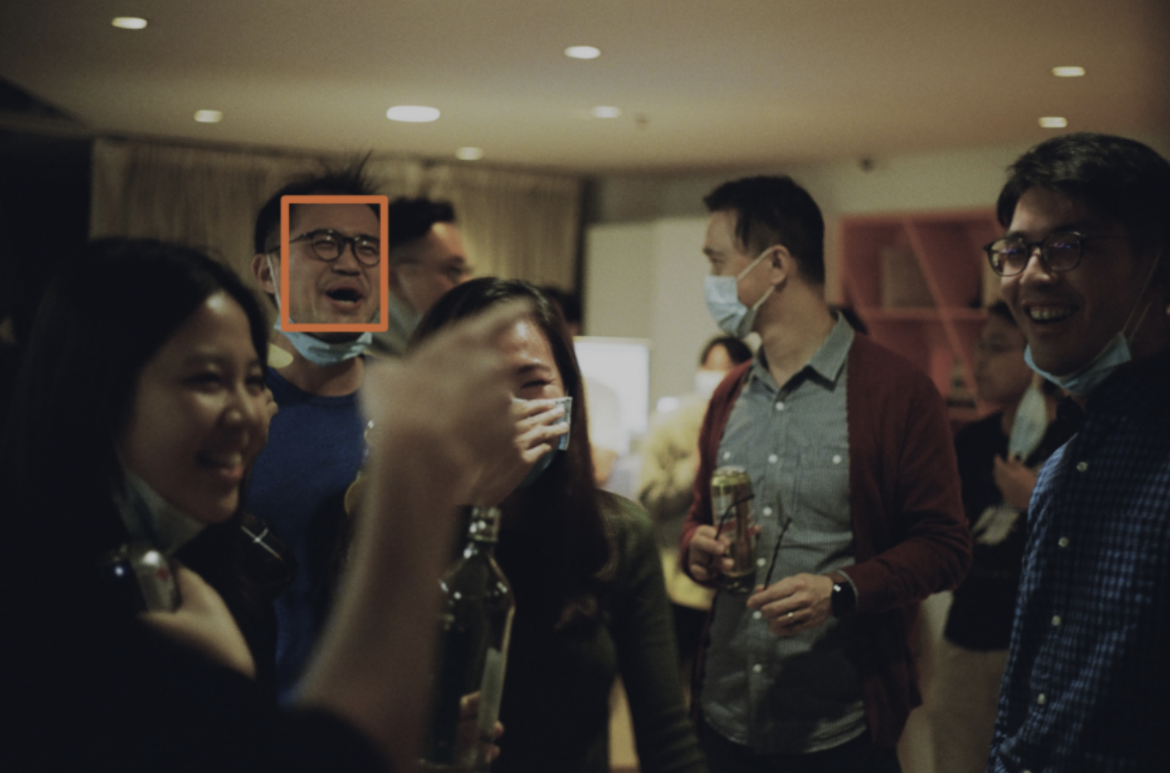
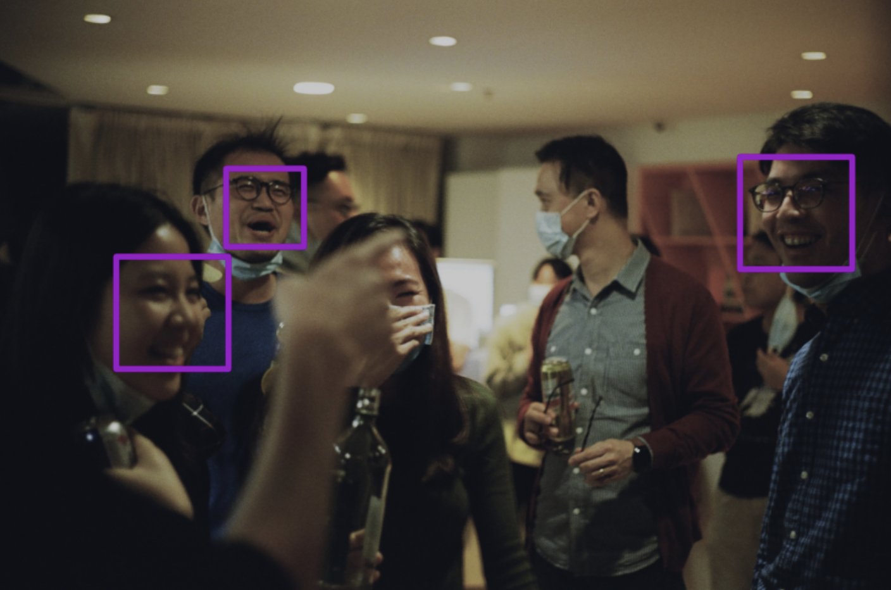
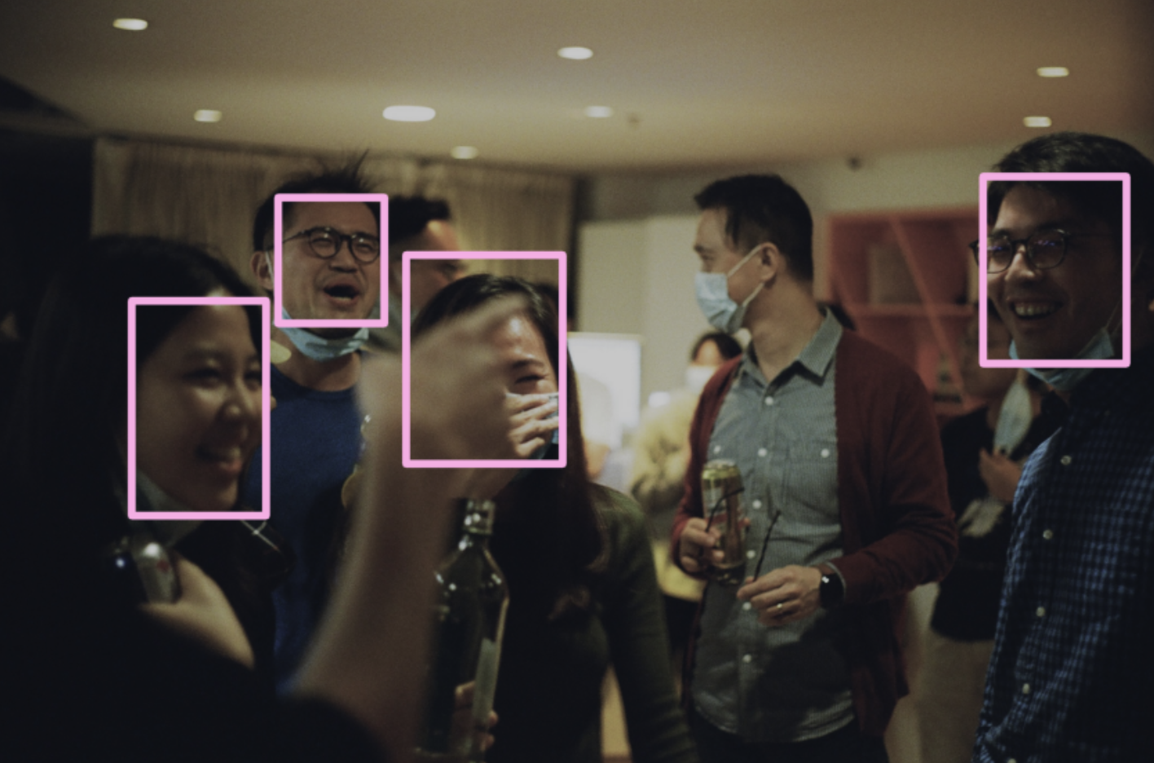
Face detection models comparison
-Low light intensity
mtcnn
haar
dlib
dnn
Notes:
In this situation, the image is dark. It’s patently obvious that opencv dnn performs the best. Also, there’s another thing which should be mentioned, ..face is covered by hand, but dnn can also detect face correctly.. incredible

Slide 14
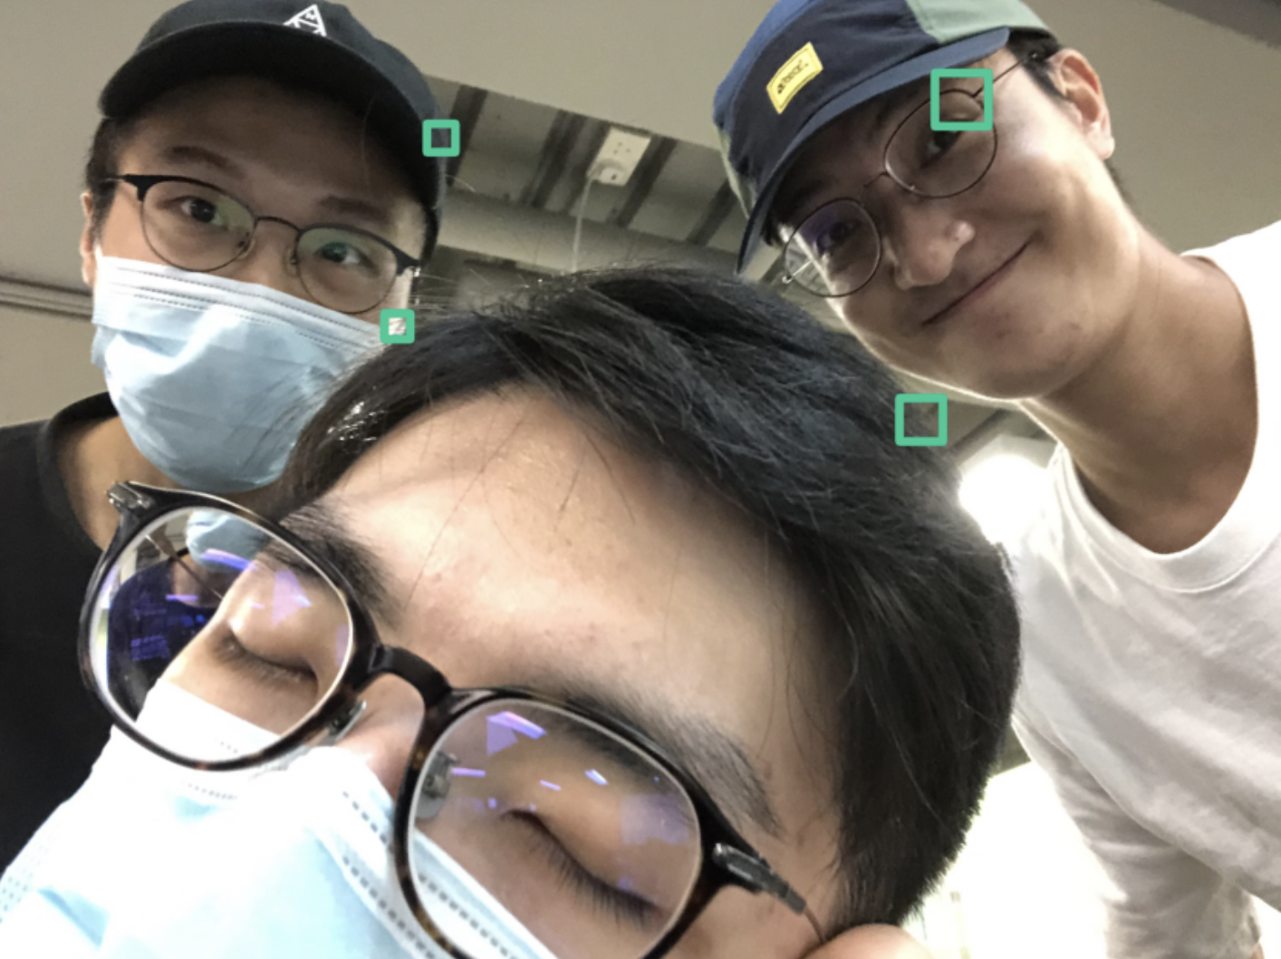
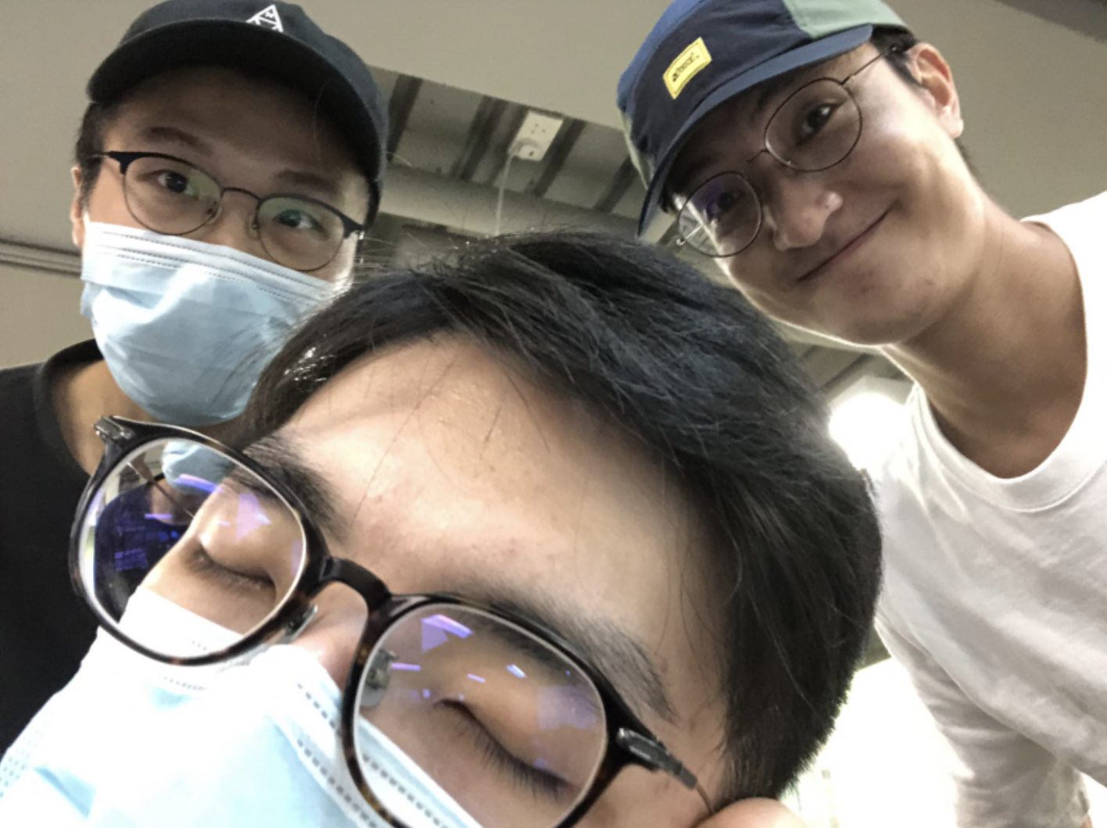


Face detection models comparison
-Occlusion of face
mtcnn
haar
dlib
dnn
Notes:
For the last case, this is an extremely tough situation for face detector model to detect human face because half of the face is covered and some guys wear a hat. Opencv dnn makes a big win in this situation.

Slide 15
Face detector (final decision)
Haar Cascade
MTCNN
OpenCV DNN
Dlib Frontal Face Detector
Notes:
Overall, since we are making the face-mask detection proj, and dnn perform the best on average. so, we are going to choose opencv dnn module face detector

Slide 16
Mask wearing classification model comparison
Face detection model
MobileNet V2
Inception-ResNet V2
Notes:
After the prog can detect where the face is, now it’s time for it to achieve face-mask detection. In order to build the face-mask detection, we were going to compare two types of pretrained model for transfer learning to see which one is better.

Slide 17
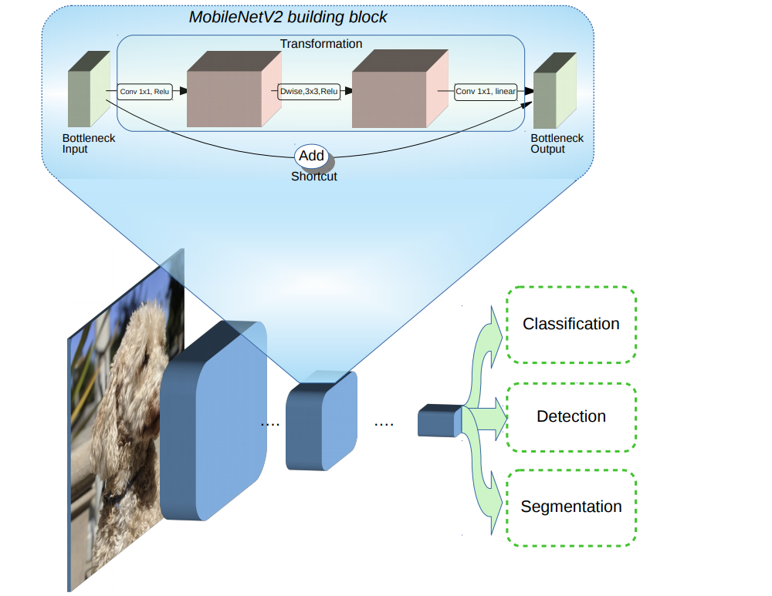
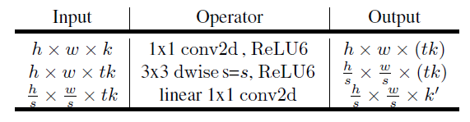
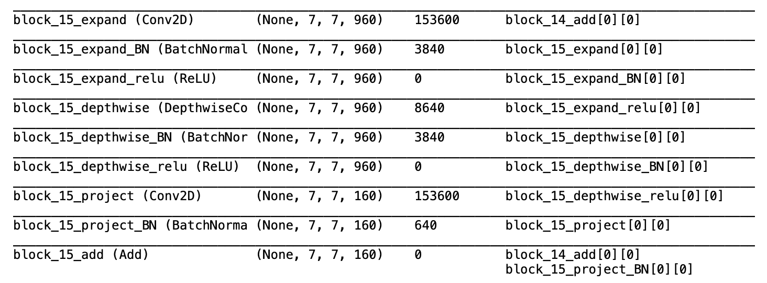
MobileNet V2
Notes:
For the MobileNet V2 pretrained model , ..simple model.. there are only 88 layers in total
So,it dramatically reduce the complexity cost and model size of the network
Suitable for the devices with low computational power.

Slide 18
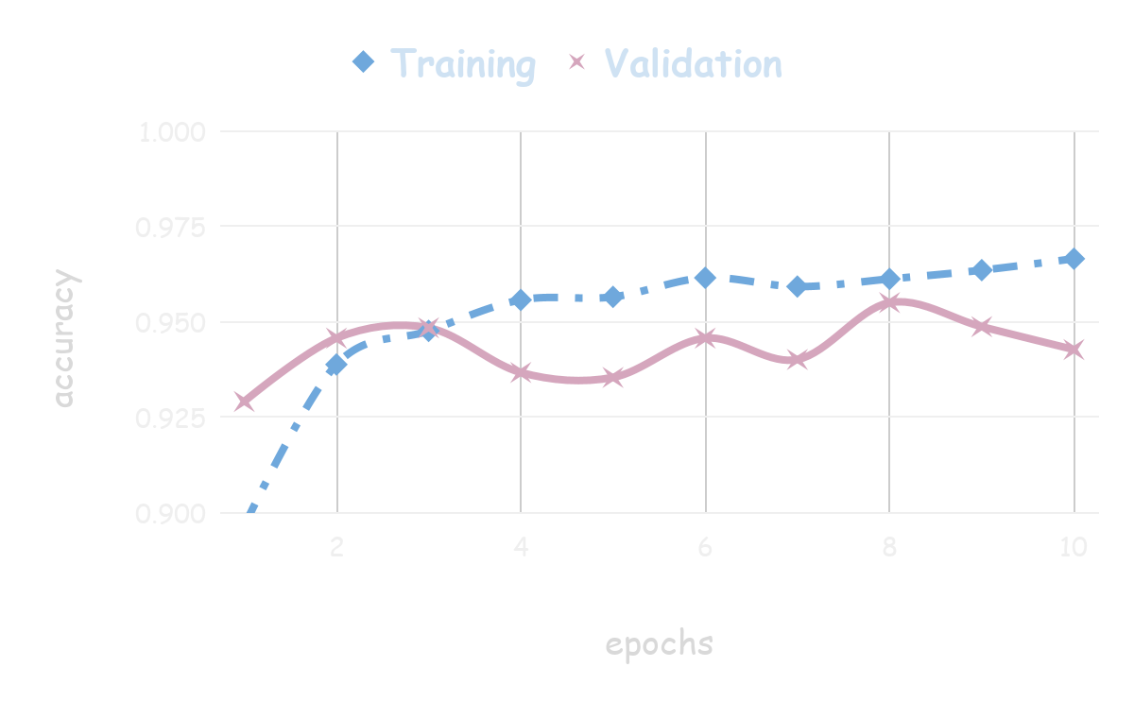
MobileNetV2
Notes:
After we trained using this model, we can see that it’s quite accurate , around 95%, not bad

Slide 19
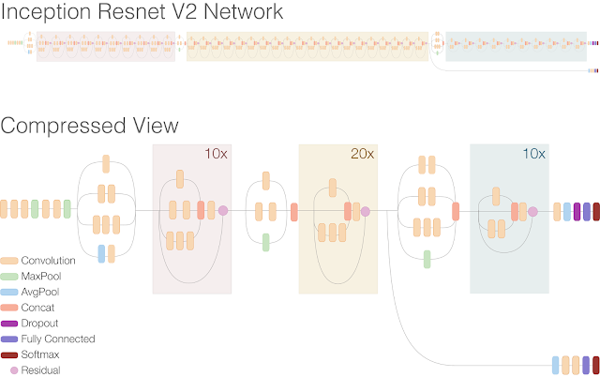
Inception-ResNet V2
Inception-ResNet-v2 is a convolutional neural architecture that builds on the Inception family of architectures
-- 572 layers deep
--1000 object categories
Notes:
Inception-ResNet V2 is a powerful pretrained model, which has totally 572 layers deep and can classify images into 1000 object categories

Slide 20
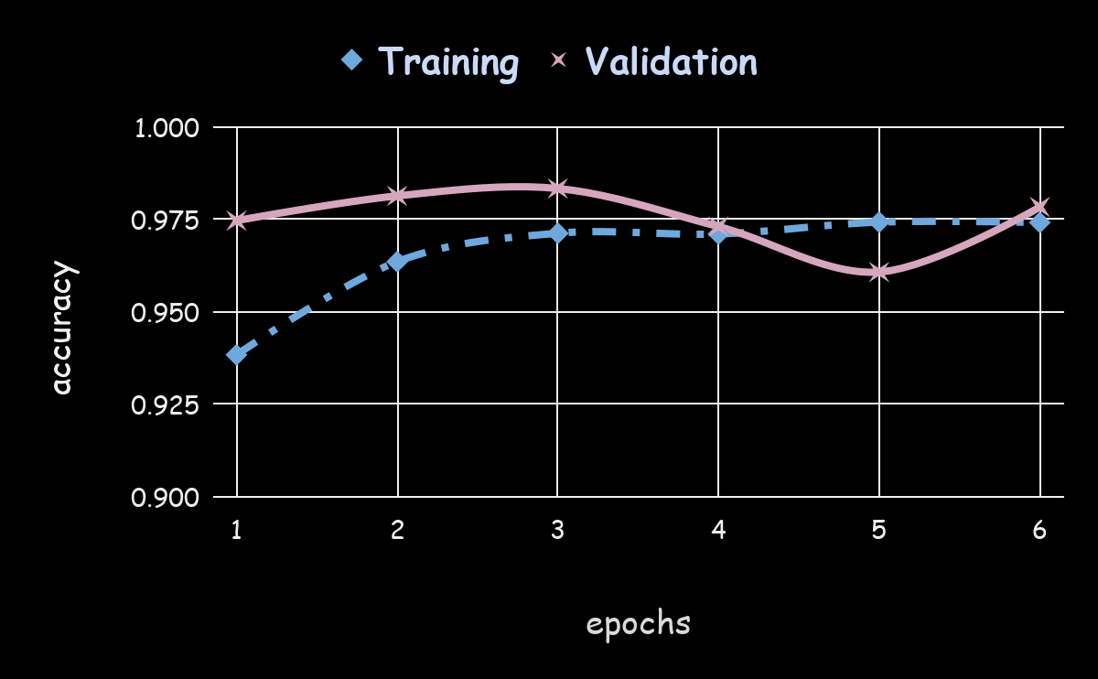
InceptionResNet V2
Notes:
Nearly all correct

Slide 21
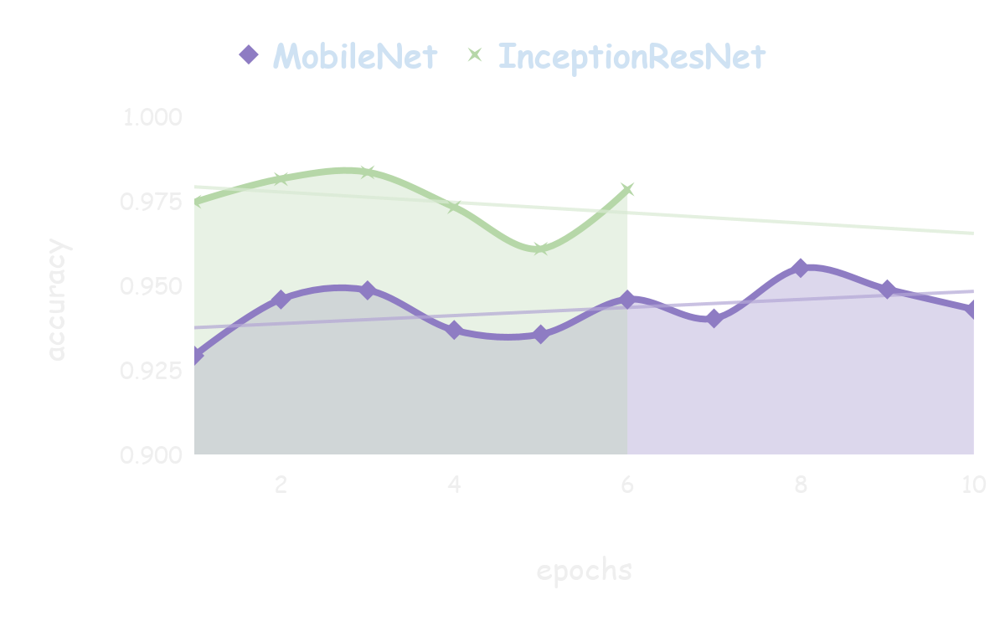
MobileNet V2 VS InceptionResNet V2
Early stopped
Notes:
So, compared with this two pretrained model, undeniably Inception-Resnet is much better than MobileNet.
However, we decided to choose MobileNet as face-mask detection model.
After a bunch of experiments on this two models, we discovered that the live-stream showed on screen will be so lagging if we use the Inception-ResNet. E.g. 30fps → 10fps
We think the reason for this is because Inception-Resnet has too much layers, and each prediction for each face in each frame will go through hundreds of layers, so the large amount of computation process will slow down the prog.

Slide 22
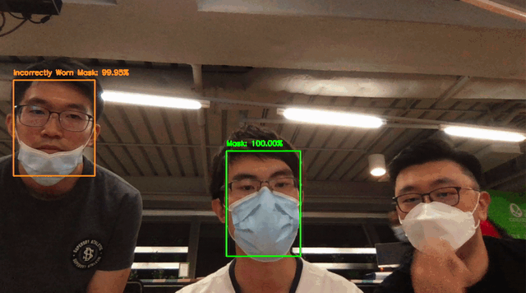
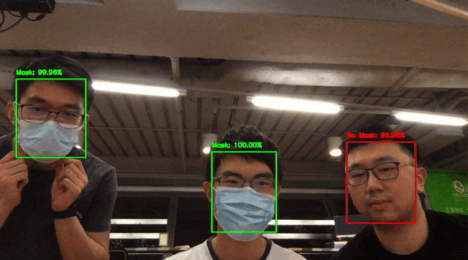
Demo
MobileNet V2

Slide 23
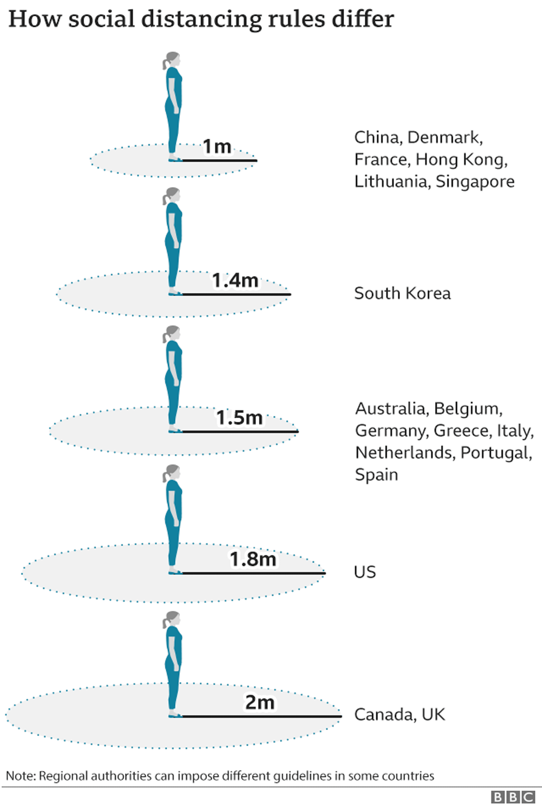
Distance Measurement
Calculate the distance between people using the coordinates of the bounding boxes drawn around the faces
Notes:
Next, I will talk about how we come up with the social distance measurement. This part is not actually very related to machine learning, but since we had done a mask classification model and deploy it, we think it is useful to add a social distance measurement into the application as well. So we actually calculate the distance between people by using the coordinates of the bounding boxes drawn around the faces.

Slide 24
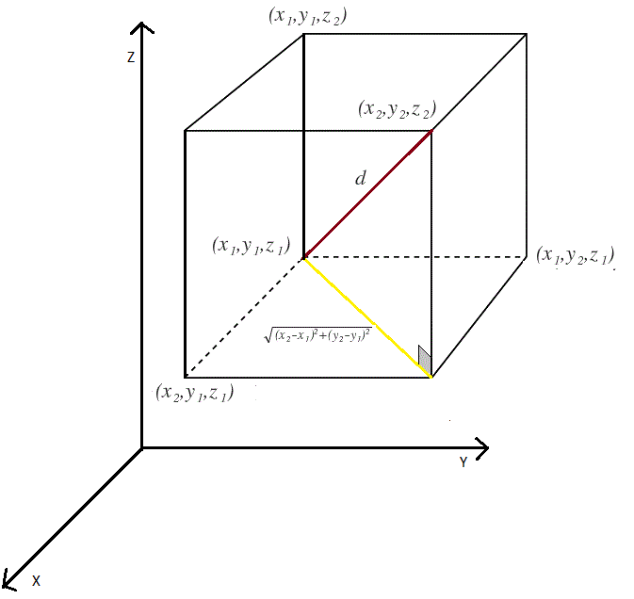
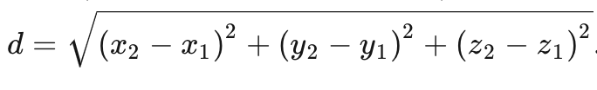
Distance Measurement
Calculate Euclidean distance in three dimensions
Notes:
We will calculate the euclidean distance in three dimensions using the formula shown here.

Slide 25
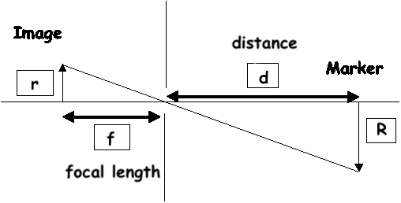
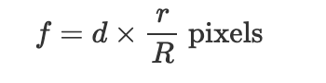
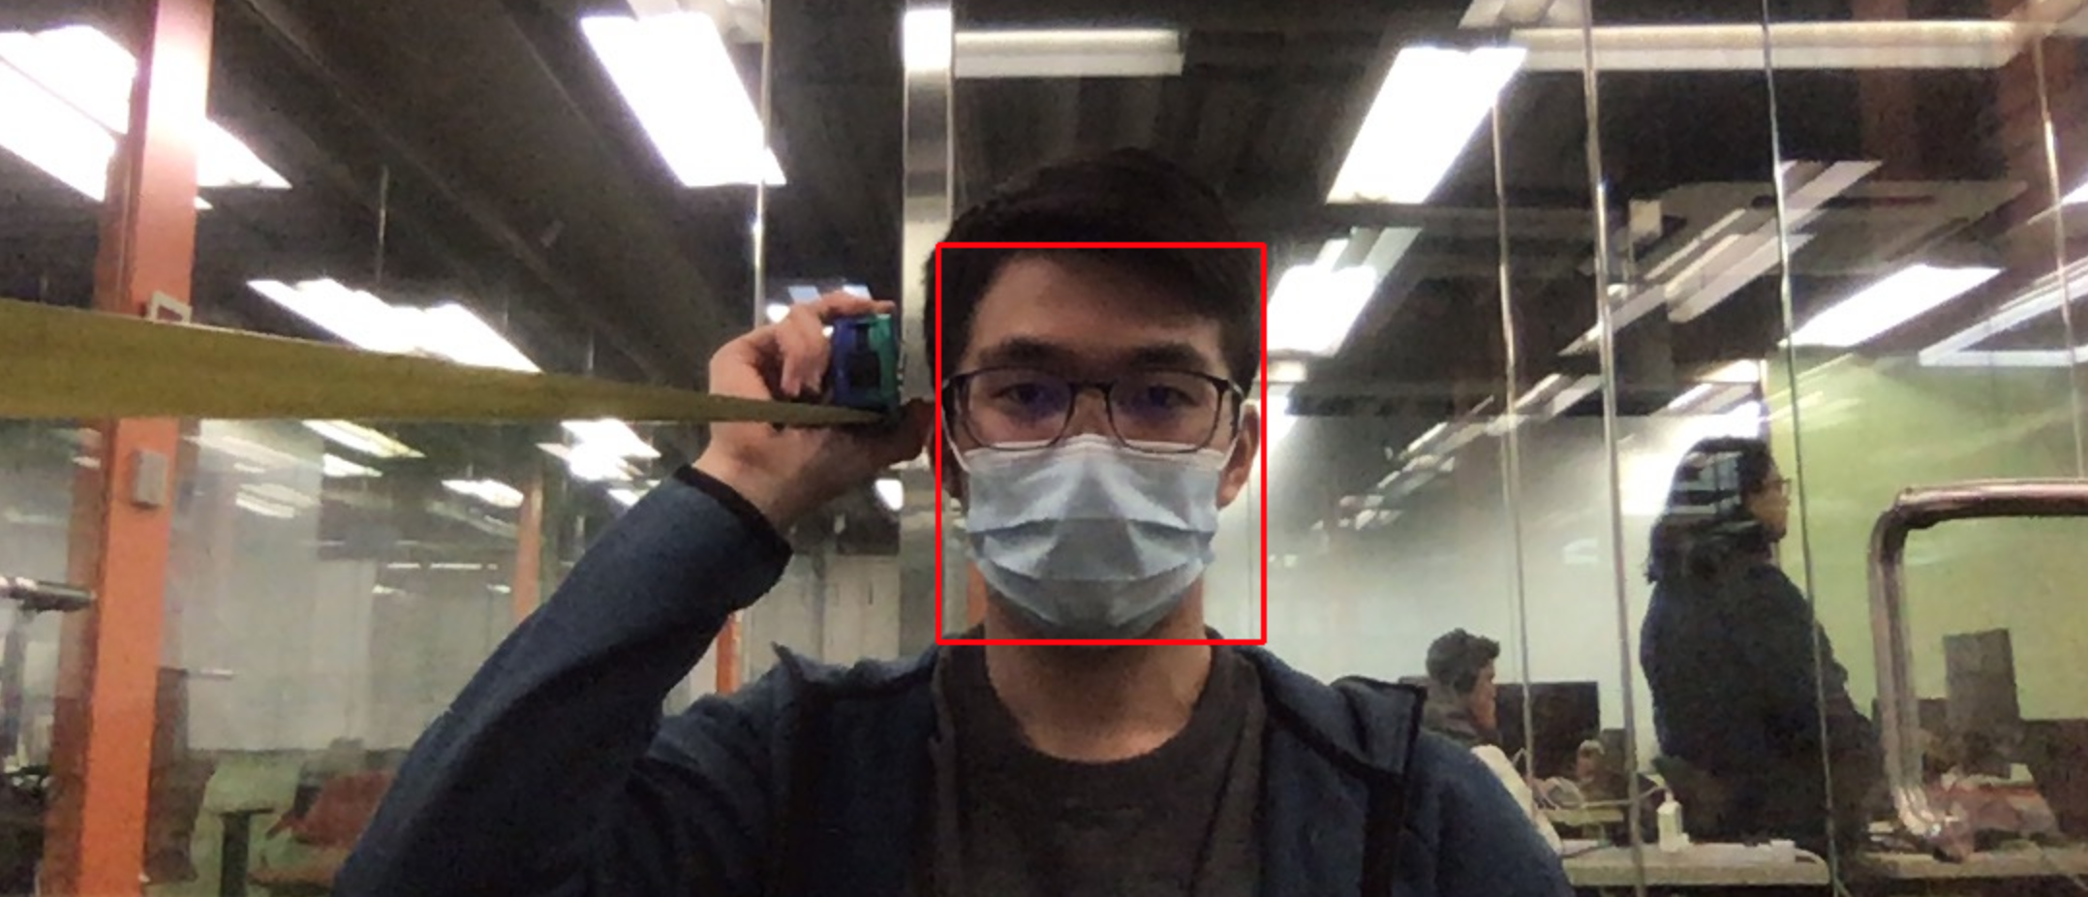
Distance Measurement
Before actually computing distance measurement:
Get the focal length of the webcam by calibrating it with an object with known width and known distance from the webcam
Notes:
And before actually deploying the app and computing the social distance, we have to the get the focal length of the web camera first by calibrating it with an object having a known width and known distance from the web camera. And then we can use this formula to get the focal length, and we found that it is around 800 pixels.

Slide 26
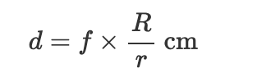
Distance Measurement
After getting the focal length:
Get the distance from the webcam, which will be the z-coordinate
And convert the x and y coordinates from pixels to cm
Notes:
Then when we actually deploy the app, the face detection model would return us the x and y coordinates in pixels of the faces. Then we can use the x and y coordinates in pixels to get the width of the face in pixels, which will be the r in lowercase as shown in the formula. Then we can use the focal length calculated and assumed face width, which is around 20cm, and the width of the face in pixels to get the distance of the face from the webcam, which will be the z coordinate. We can also convert the x and y coordinates from pixels to cm using the second formula, with the distance from camera we just calculated. At last, we will have the x, y, and z coordinates of each face in centimetres, and can calculate the distance between the faces.

Slide 27
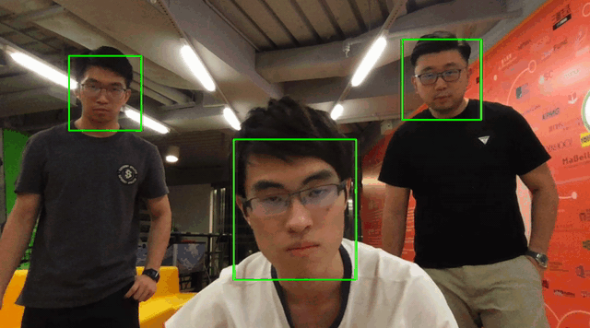
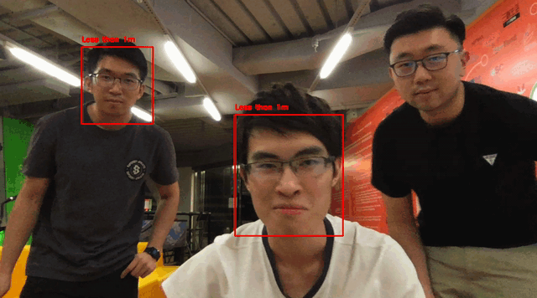
Demo
Social Distance Detection
Notes:
And this is our result, which shows a red bounding boxes when the distance between any two faces is less than 1m, or else shows a green box.

Slide 28
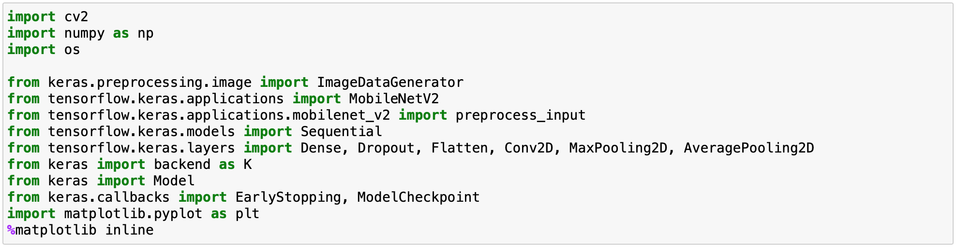
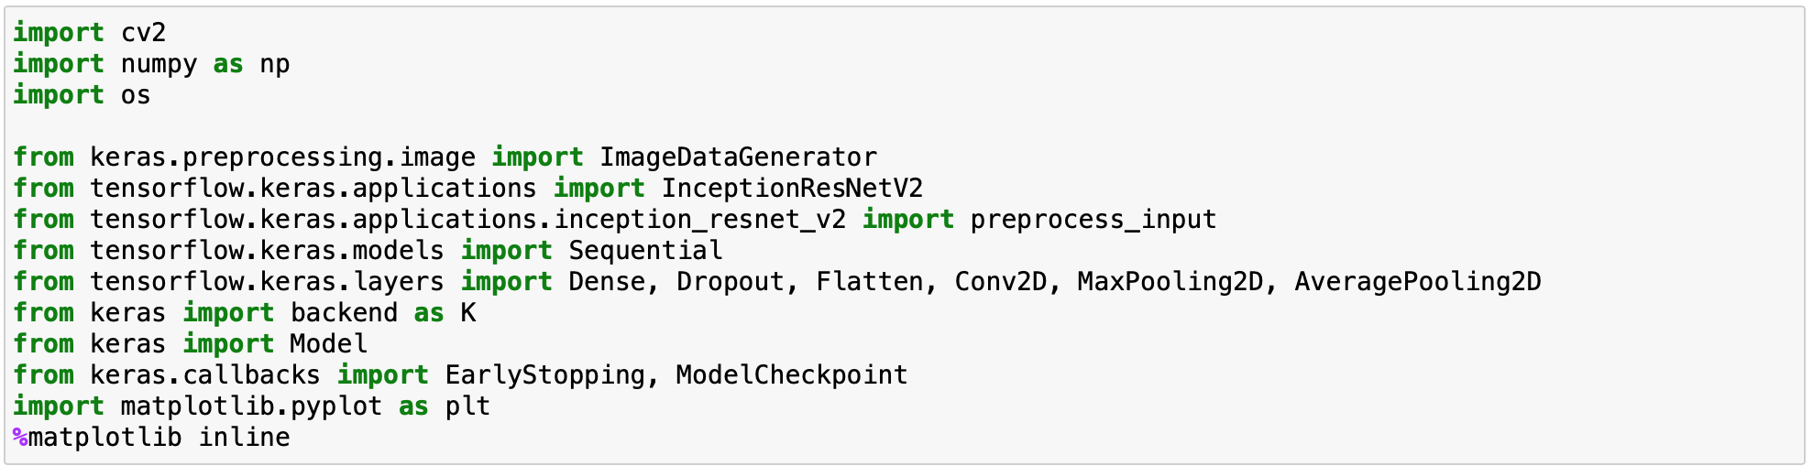
Codes walk-thru
Import all the libraries needed for the model creation:
<-MobileNetV2
InceptionResNetV2 ->
Notes:
Training notebooks
Facedetection model selection notebook
Focal lenght py
Detection py

Slide 29


Codes walk-thru
Use ImageDataGenerator to feed in images:
InceptionResNetV2
MobileNetV2
Notes:
Training notebooks
Facedetection model selection notebook
Focal lenght py
Detection py

Slide 30


Codes walk-thru
Compose the model for transfer learning
<-MobileNetV2
InceptionResNetV2 ->
Notes:
Training notebooks
Facedetection model selection notebook
Focal lenght py
Detection py

Slide 31

Codes walk-thru
Model training with early stopping & model checkpoint:
Notes:
Training notebooks
Facedetection model selection notebook
Focal lenght py
Detection py

Slide 32

Codes walk-thru
- Create a plot to see the training and validation accuracy across the whole training
- Save the final model, and leave it for later loading in the face detection part
Notes:
Training notebooks
Facedetection model selection notebook
Focal lenght py
Detection py

Slide 33
01
Display & next frame
Pre-process frame
05
programme
Code flow
02
For each frame:
Detect # of faces
Bounding box & text
04
03
Face-mask detect
Distance estimate
Notes:
It’s the main code flow on how to display the face-mask detection on the screen.
After we convert the live-stream to image, first step is pre-process each image,
……...

Slide 34


Load the models & initialize camera
Read each frame & sett the frame size
Notes:
Explain the code
1.load the model and initialize the camera.
2.make a while loop to loop each frame respectively and set the size of the frame

Slide 35



Pre-process the frame
Inner bounding box
detection.shape==(1,1,200,7)
Notes:
Pre-process each frame and perform a forward pass
So, now the detections variable represents an array with 200 rows and 7 columns
The second column in the detections parameter represent confidence
Looping each confidence parameters, when confidence larger than 0.5, that means this part is detected as a face.
And also we get the coordinate and make a bounding box for face detection

Slide 36

Notes:
Here we only make prediction if at least one face was predicted
Make batch predictions on all faces at the same time rather than one-by-one predictions
we return a 3-tuple of the face locations, they corresponding mask wearing predictions, and whether there is violation of social distancing rule

Slide 37


Display the label and bounding box colour
Right bottom corner bounding box and text display

Slide 38

Codes walk-thru: focal length calibration
Notes:
The code here shows how we calibrate the focal length of the camera.
So we first take an image, and use the face detection model and detect the face in the image.

Slide 39

Codes walk-thru: focal length calibration
Notes:
The model can return us the x and y coordinates in pixels, and allow us to calculate the width of the face in pixels.

Slide 40

Codes walk-thru: focal length calibration
Notes:
Here, we already know the distance is 100cm and the known width of the face is 17cm, then we can calculate the focal length by using the formula mentioned before.

Slide 41

Codes walk-thru: social distance measurement
Notes:
After getting the focal length, we can actually deploy the app and calculate the social distance using the focal length and we assume the face width to be 20 cm.
Firstly, the centroid function uses the x and y coordinates of the bounding box around the face to get the x and y coordinates of the center point of the frame image and also the width of the bounding box.

Slide 42

Codes walk-thru: social distance measurement
Notes:
Then the cal_distance function uses the assumed face width, the width of the bounding box and the focal length to calculate the distance of the face from the camera, which will be the z coordinate.

Slide 43

Codes walk-thru: social distance measurement
Notes:
When we loop over each of the face in each frame, we also applies the centroid function and the cal_distance function to get the x y and z coordinates of each face.

Slide 44

Codes walk-thru: social distance measurement
Notes:
Then, we calculate the distance between each face, if it is smaller than 100cm, then we assign the corresponding face a value of 1.

Slide 45


Codes walk-thru: social distance measurement
Notes:
If the value is one, then we sets the bounding box to red, and displays a warning of less than 1m, otherwise, the box is green.

Slide 46

Codes walk-thru
Notes:
Lastly, the code here displays a box at the bottom right hand corner, which shows in real time how many people are wearing mask incorrectly, not wearing mask, or violating social distancing rule.

Slide 47

Break the loop
Notes:
So in the end, we can type q to quit the while loop and end the application

Slide 48
Challenges
Further improvement
Train the mask classification models with photos showing people covering their mouths with other objects
Train our own face detection model
Connect the app to an external camera
Detect the whole body rather than only the face and use its bounding box to calculate the distance in between
(e.g.yolov3)
Difficult to detect faces that are faraway
The mask classification model cannot distinguish between masks and other objects that cover the mouth
Cannot detect violation of social distancing if people are not facing the camera
Notes:
For challenges, the current face detection model seems unable to detect faces that are faraway. For the mask classification model, it cannot distinguish between masks and other objects that cover the mouth. So when someone uses a tissue paper to cover his mouth, the model might still classify him as having worn a mask. Finally, since we are only using the face detection to calculate the social distance, we cannot detect the distancing violation if people are not facing the camera, which might render the app not so useful after all.
So for further improvement, we can train the mask classification models with photos showing people that cover their mouths with other objects, so that our model can correctly identify those people as not wearing masks at all.
We can also try to train our own face detection model, for instance, we can use the current face detection models as the base model, and add photos of people wearing masks to train a new face detection model that can better detect people that wear masks.
Moreover, we can connect the app to an external camera, so that it can capture a larger area and more people so as to be practical in detecting violation of the mask or social distancing rules.
Finally, we can use object detection models such as yolov3 that can detect the whole body rather than only the face and use its bounding box to calculate the distance in between, so that even when the people are not facing the camera, we can still calculate the social distance.

Slide 49
Q&A session

Slide 50
Face-mask & Social distance detection
Live-stream showcase

Slide 51
End

